Slide 1
GenAI Integrated Conversational Business Intelligence Assistant

Slide 2
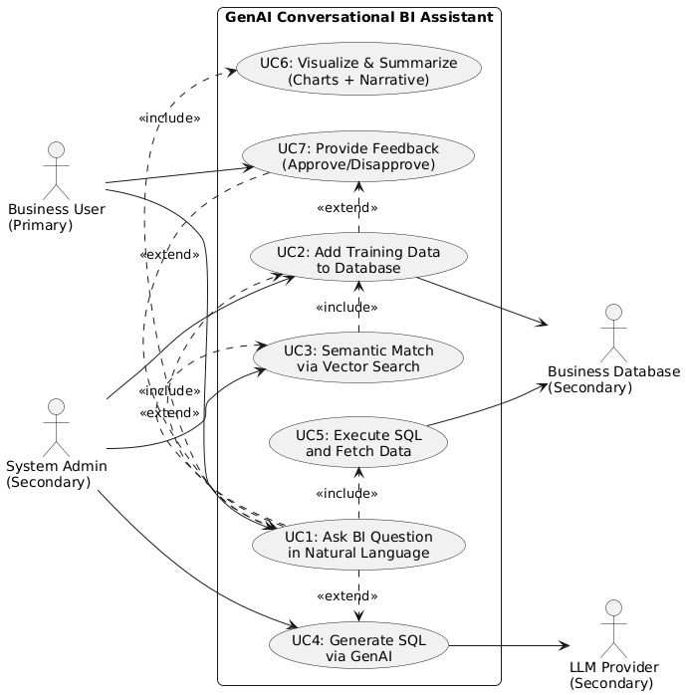

Slide 3
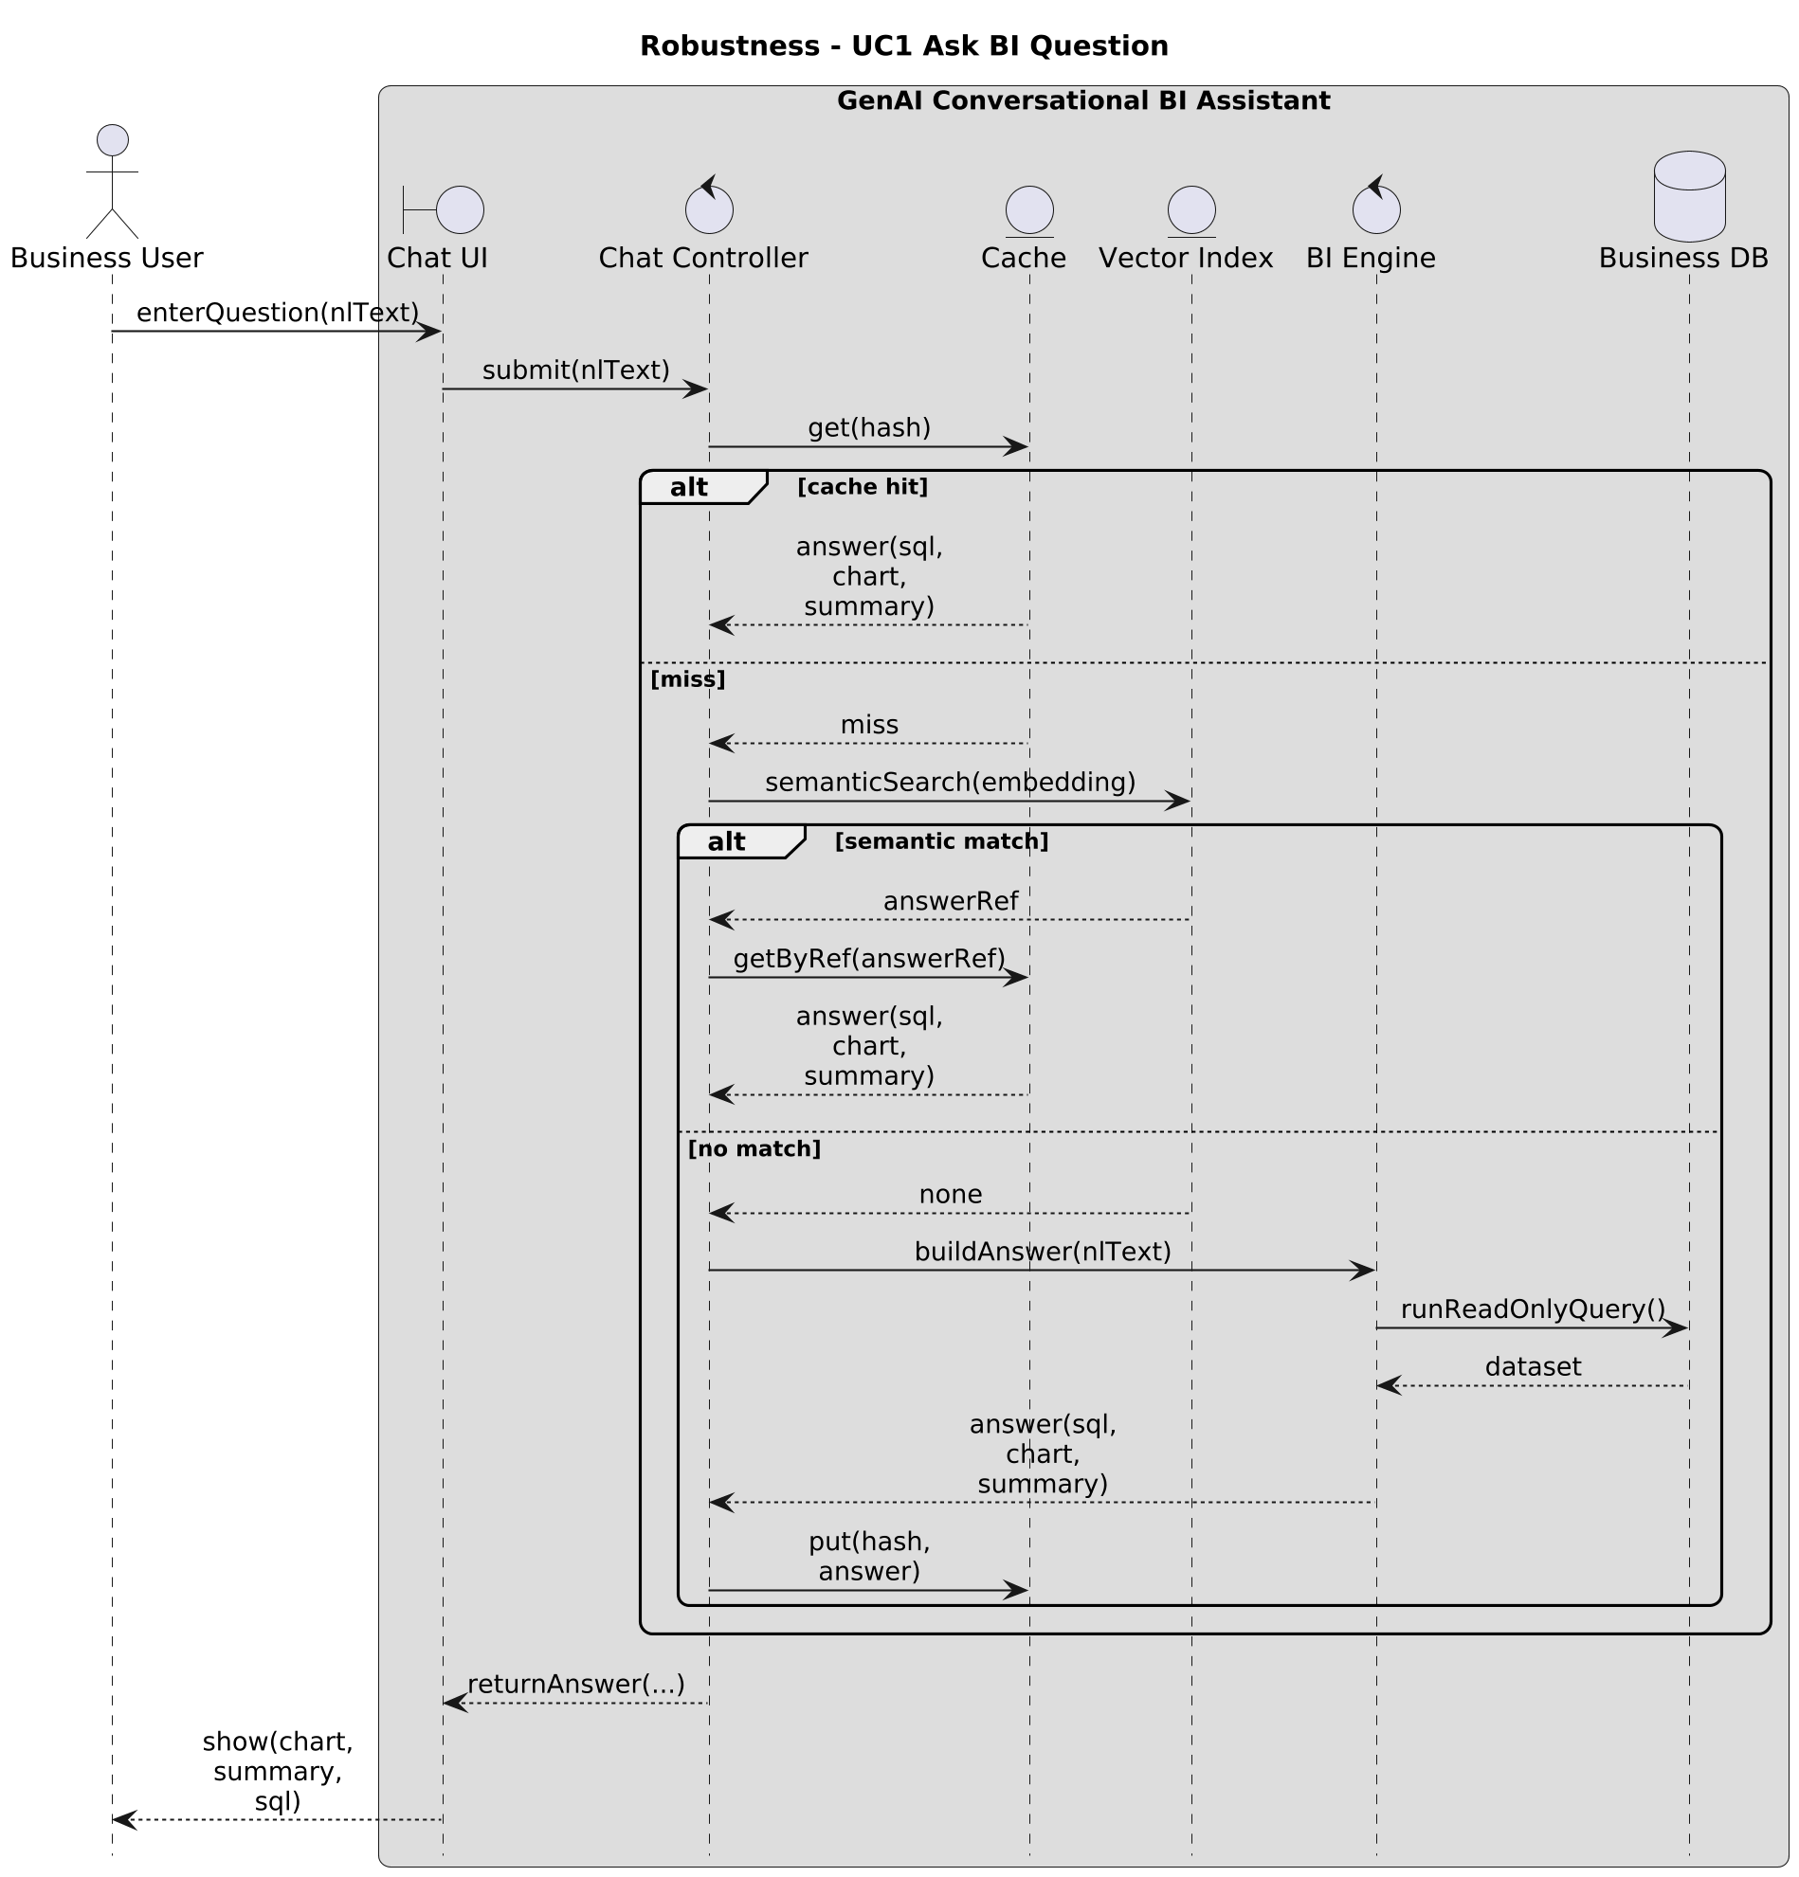

Slide 4
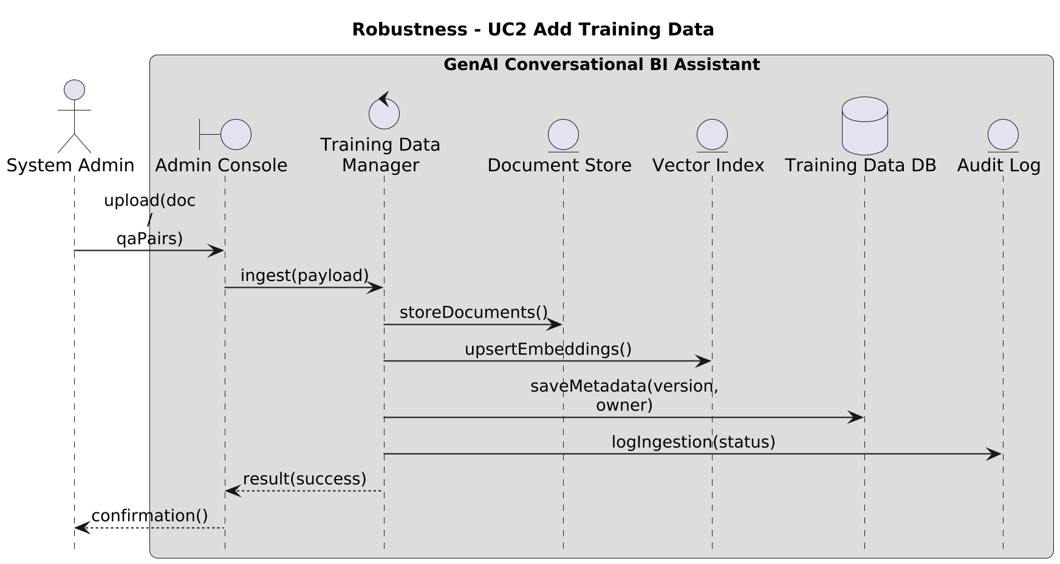

Slide 5
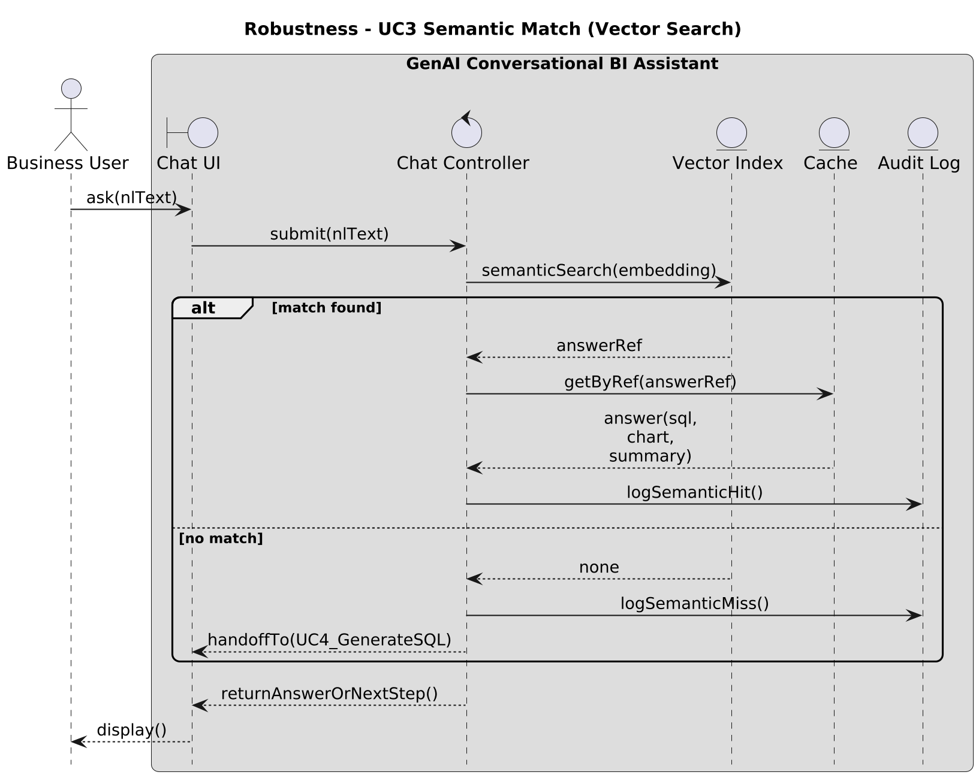

Slide 6
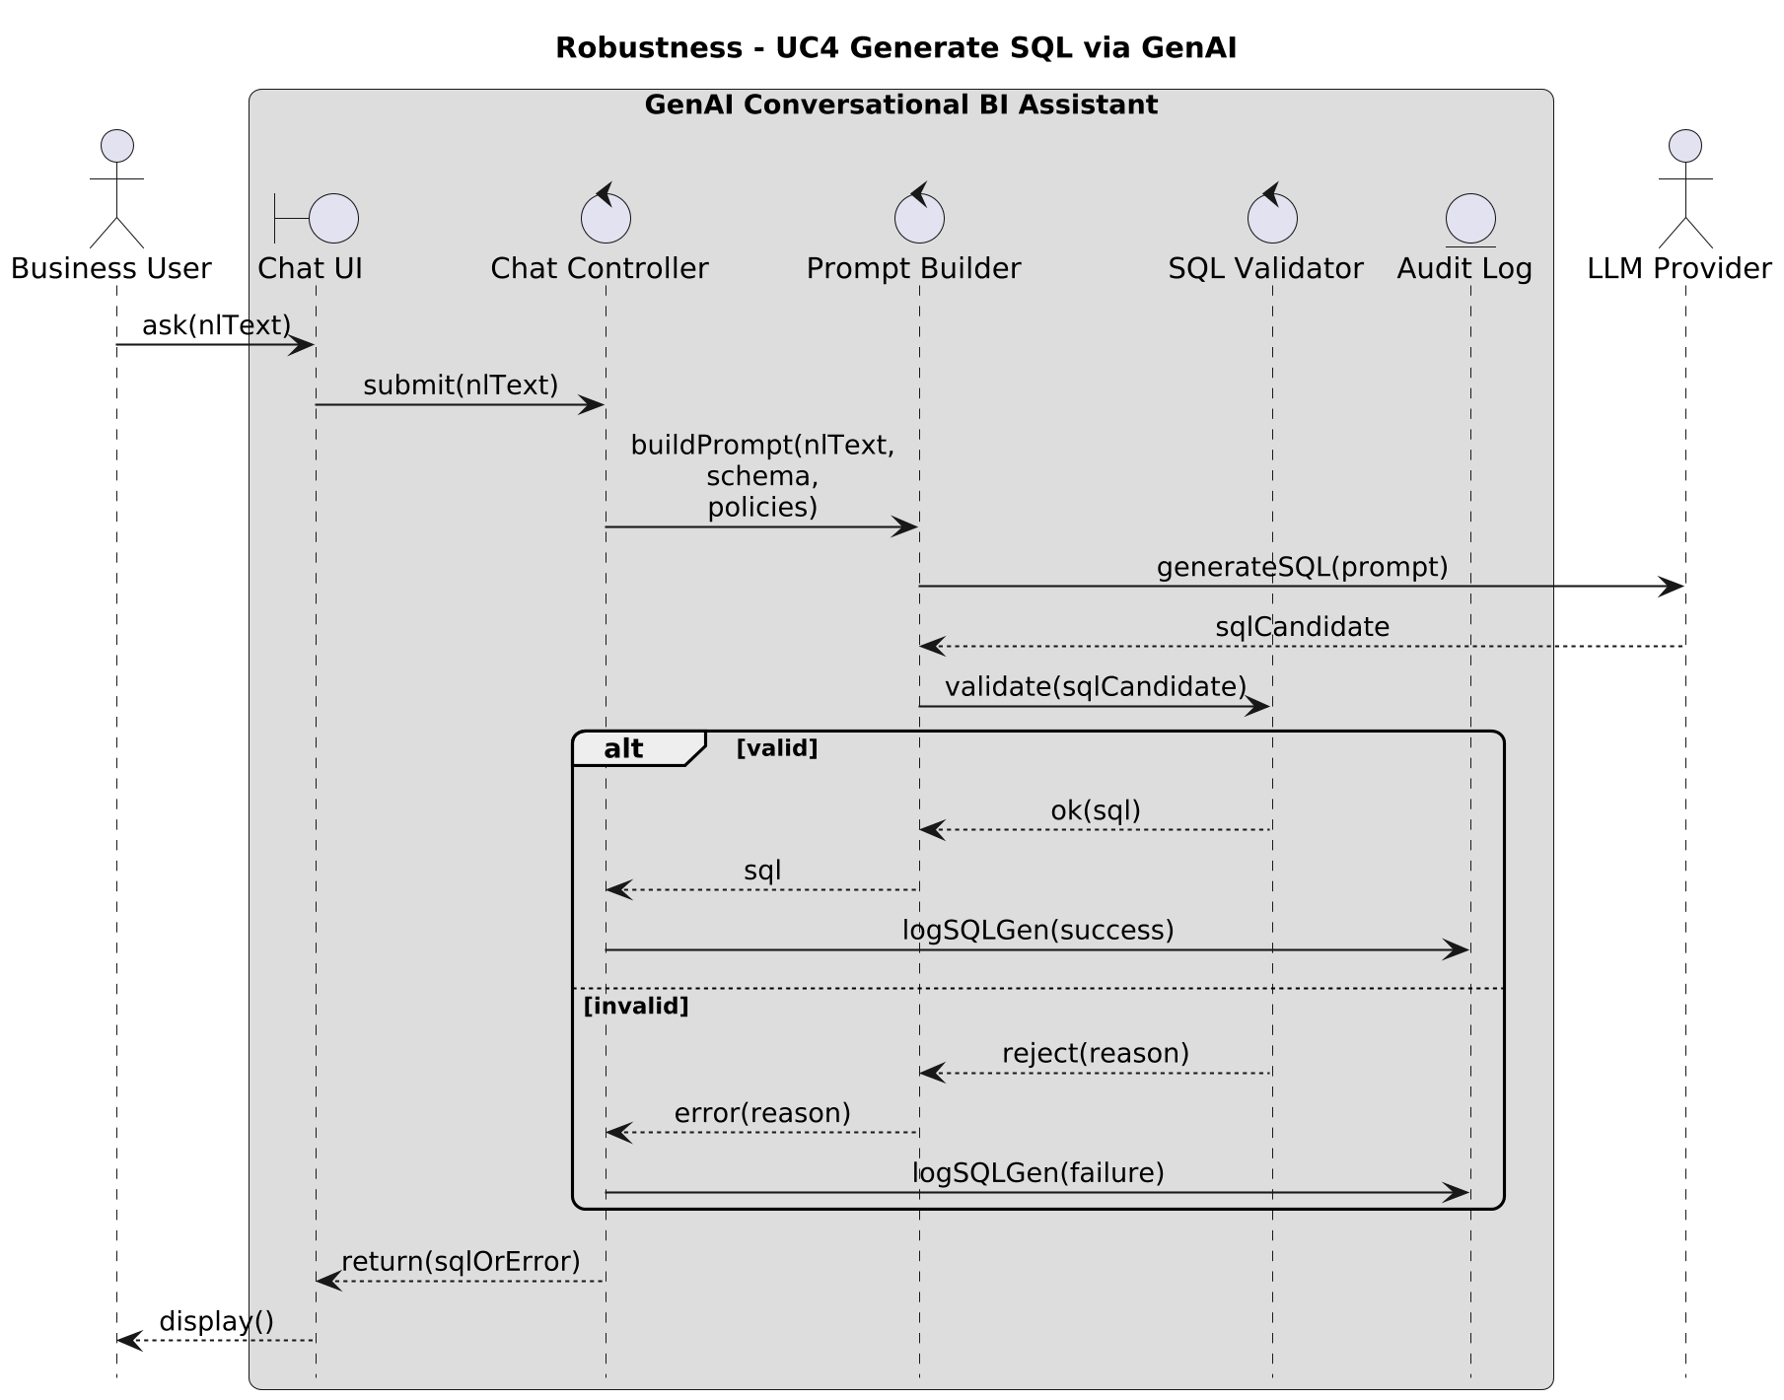

Slide 7
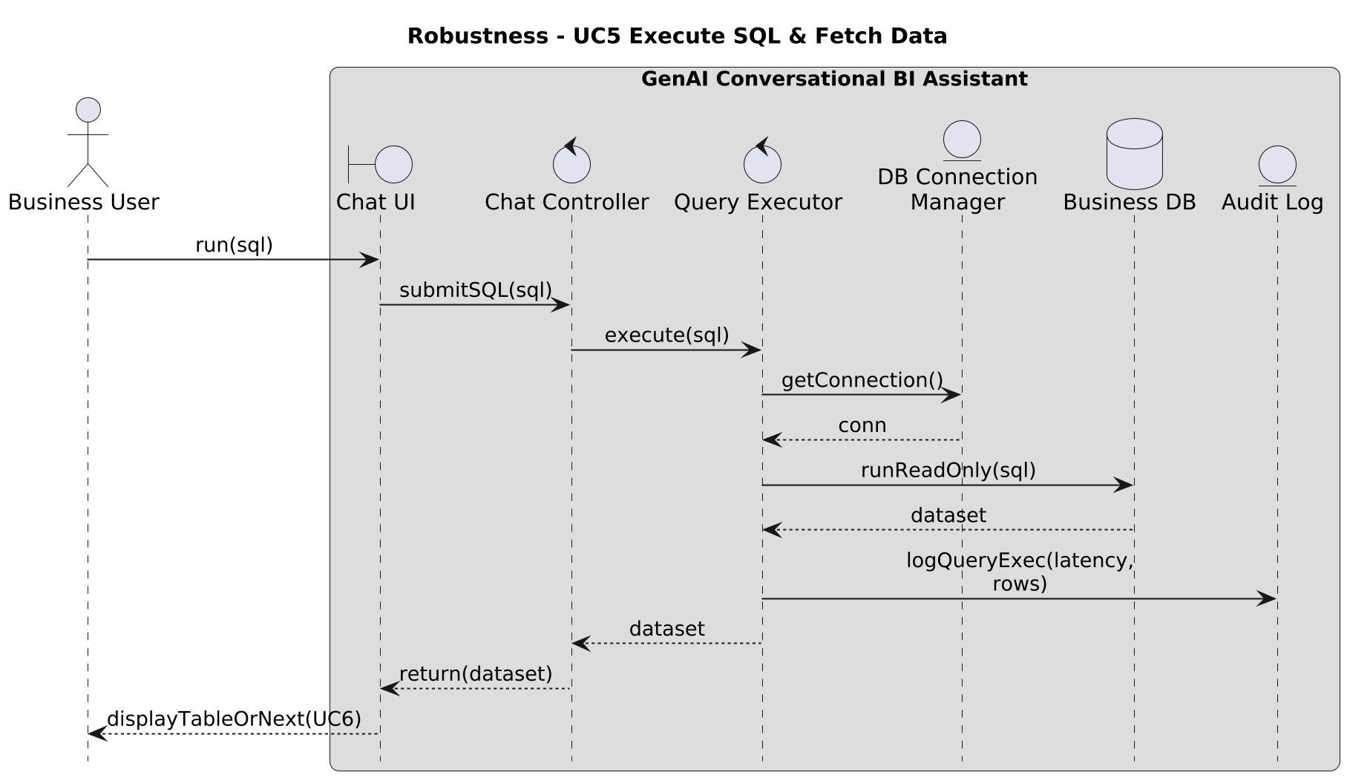

Slide 8
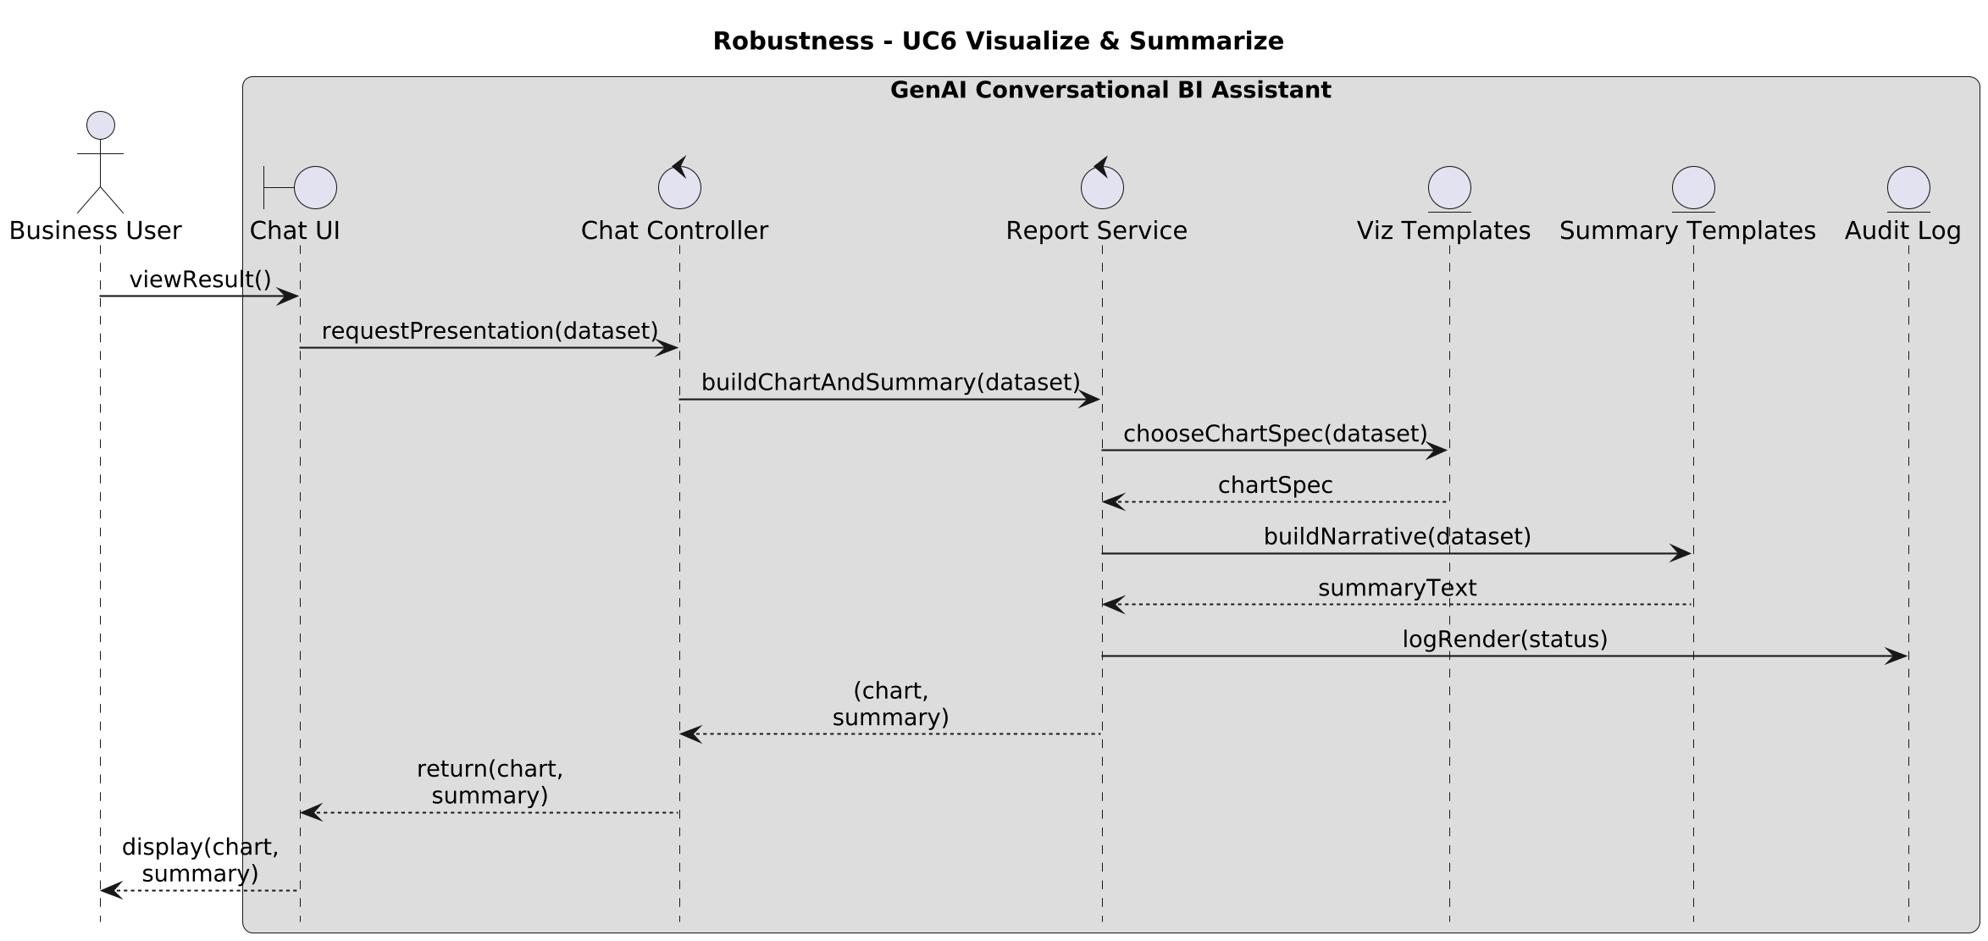

Slide 9
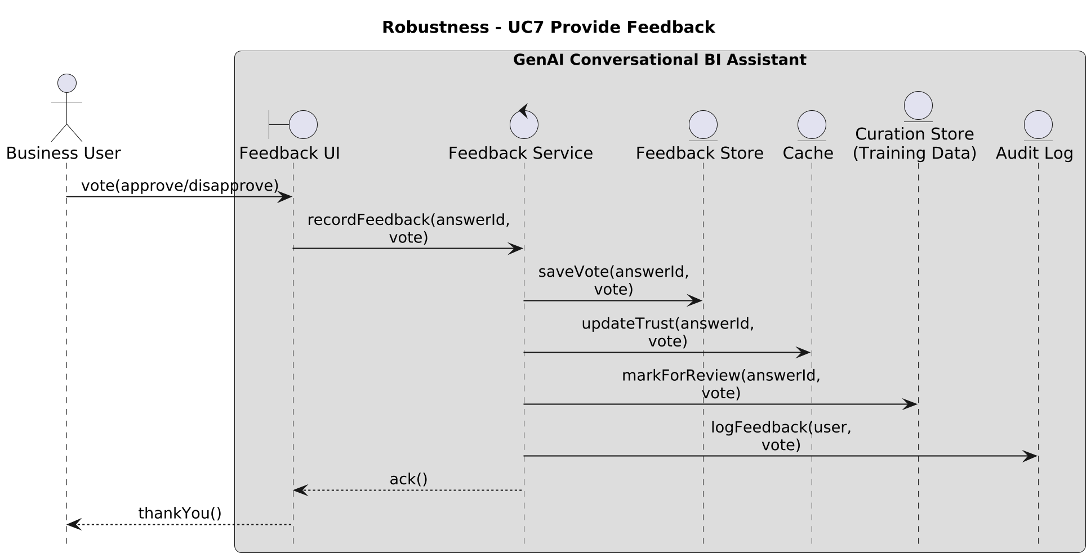

Slide 10
Thank you
Brita Tamm
502-555-0152
brita@firstupconsultants.com
www.firstupconsultants.com

